Slide 1
PSYC 4973: Special Topics in Memory
Course Overview
Notes:
Welcome to cognition! Hopefully you are watching this video first!

Slide 2
Who is this person?
Dr. Maxwell
Cognitive Psychologist
  Research interests in memory and language

Slide 3
Contacting Dr. Maxwell
How to contact me:
Email: nicholas.maxwell@msutexas.edu
  Please put course # and section # in header!
  24 – 48 hours (except on weekends)
In person! OD 118; Office hours: MWF: 10am – 11am; W: 1pm – 3pm

Slide 4
What do I get out of this Class?
A deeper understanding of cognitive psychology, including its history and current research trends.
A comprehensive understanding of memory, including how it relates to other cognitive systems (e.g., attention, language, etc.)
An appreciation of the role of memory in everyday life.

Slide 5
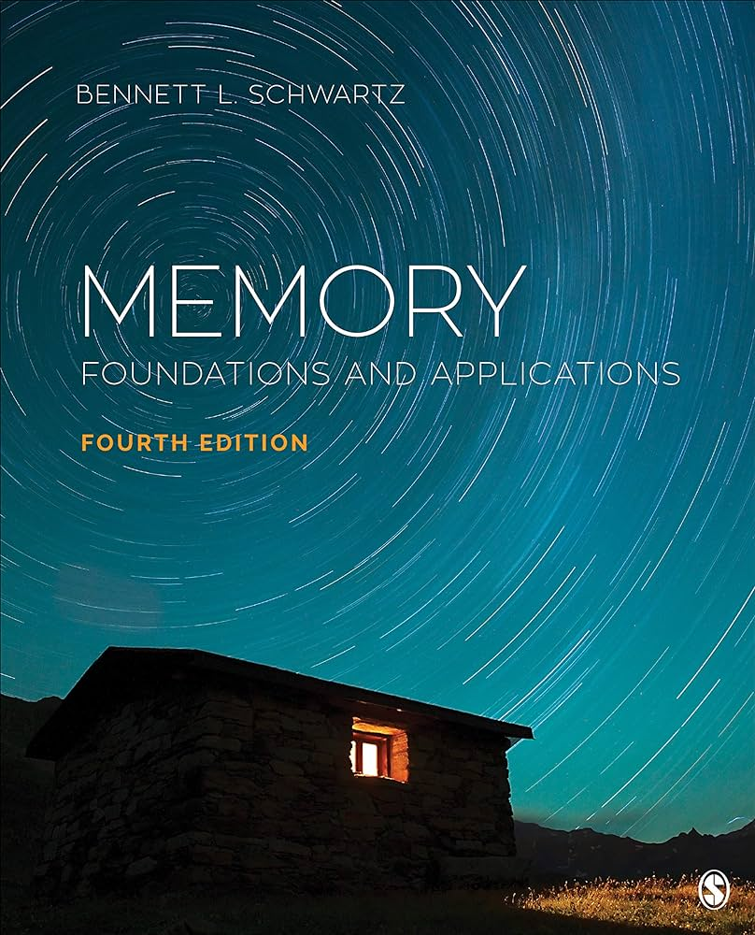
What will I Need?
Textbook: Memory: Foundations and Application by Bennett L. Schwartz (4th Edition) (2020)
Something to take notes with
You!

Slide 6
What’s expected of you
3 Exams (1oo pts each; 300 pts total) (60%)
Weekly Chapter Quizzes (150 points) (30%)
  Lowest grade dropped
Attendance/Participation (50 points) (10%)

Slide 7
Questions??

